Slide 1
Texas Games Battle of the Bomb! Baylor University, 23 March 2024 1000-1700
C/Col Duncan
Capt Renner

Slide 2
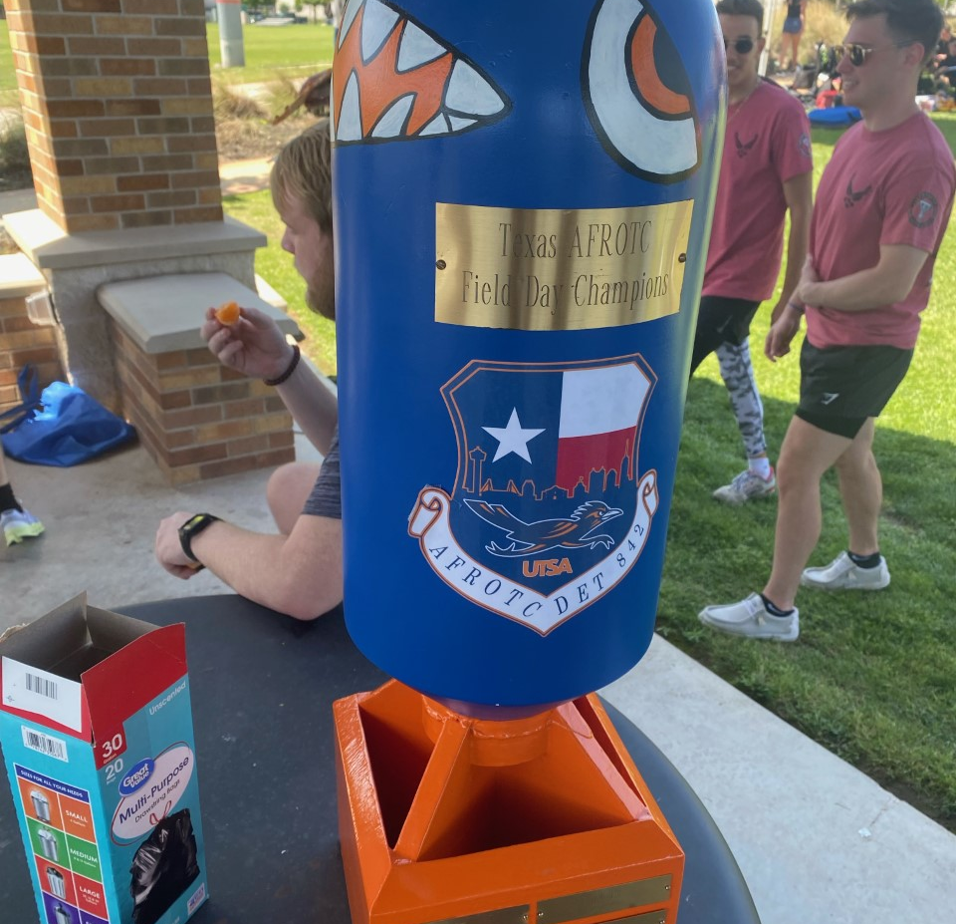
Texas Games
The Texas Games is held annually between all ten detachments in the state of Texas.
Detachment 810 of Baylor University will host the annual Texas Games for all ten Texas AFROTC detachments on 23 March 2024.
Opportunity for cadets from across Texas to network and share ideas/experiences, while enjoying friendly competition, ultimately boosting morale, and increasing connectivity.
The “Battle of the Bomb” trophy is a wooden “bomb” that is decorated/painted by the winning detachment, and brought every year to the event

Slide 3
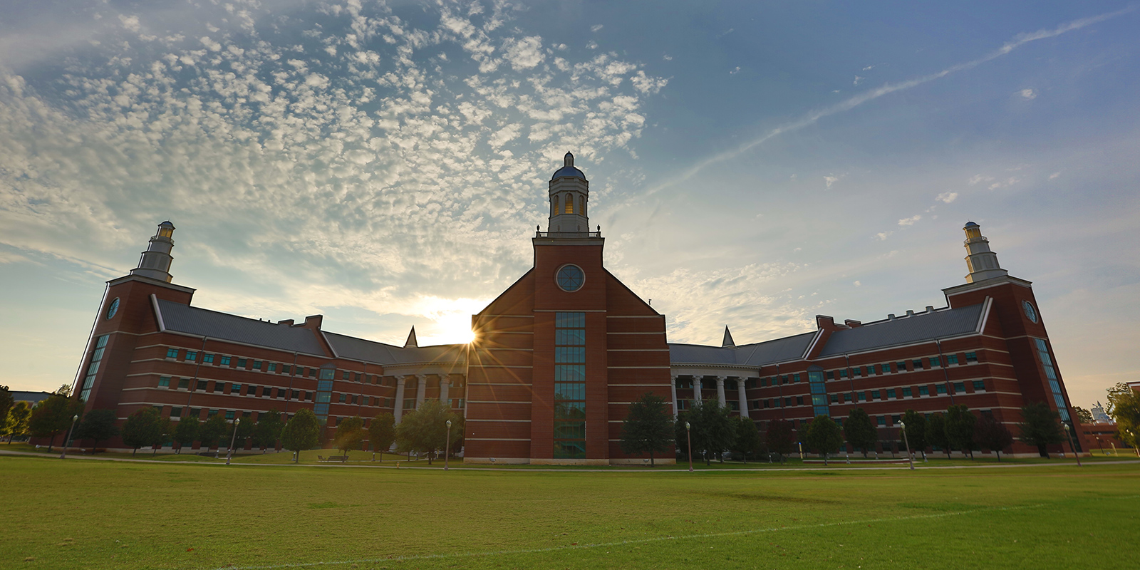
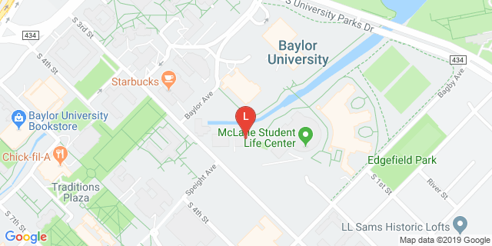
Baylor Science Building Fields & Russell Gym
BSB Fields
Russell Gym
101 Bagby Ave. Waco TX 76706
Parking is TBD

Slide 4
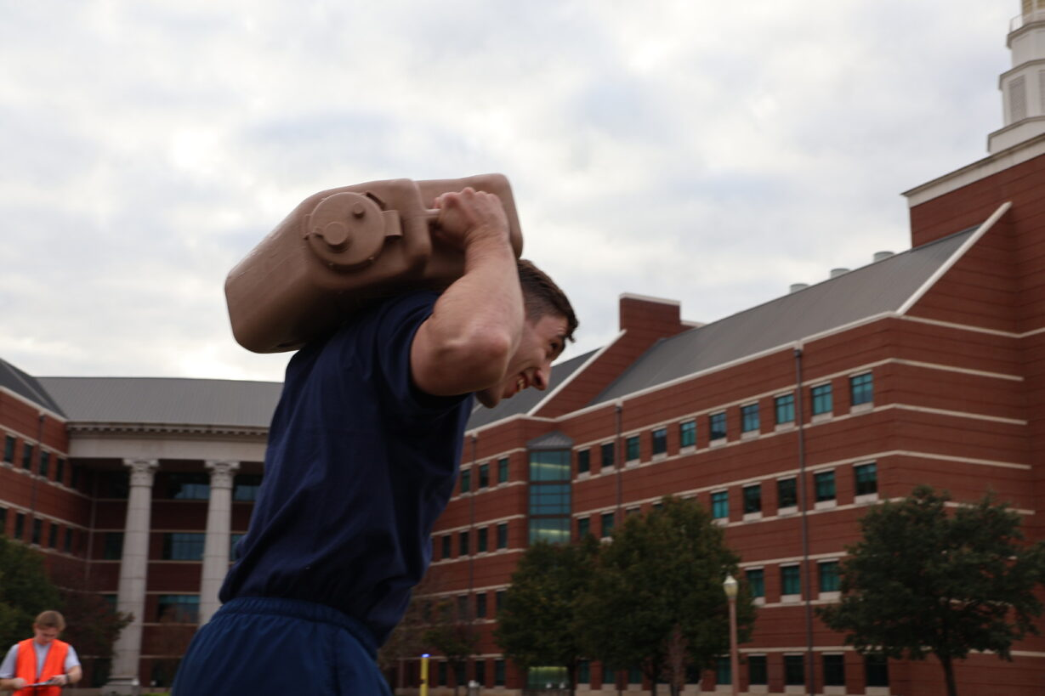
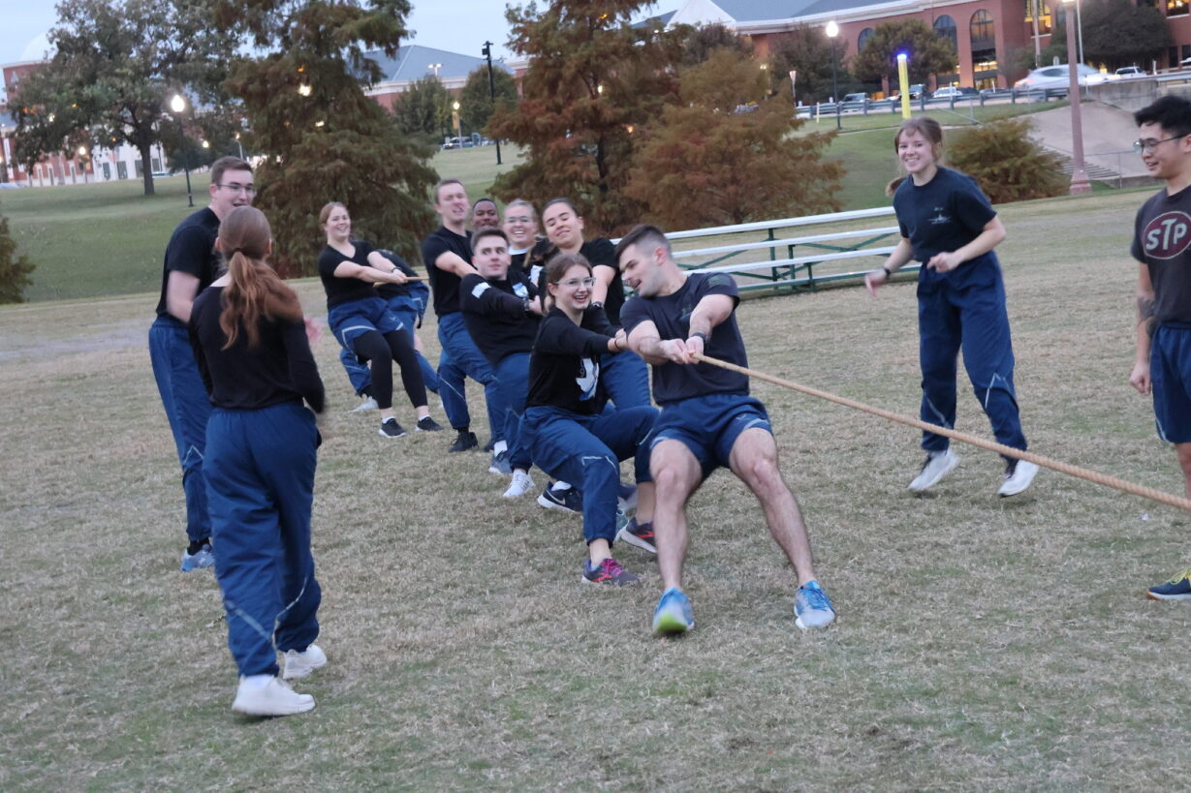
Competitions
Flag Football
Ultimate Frisbee
Indoor Volleyball
Team challenges:
Tug of War
Relay Races
Etc…
Must have at least one female on each sport team
Rule Book/Schedule/ Scoring will be published and sent out prior to event

Slide 5
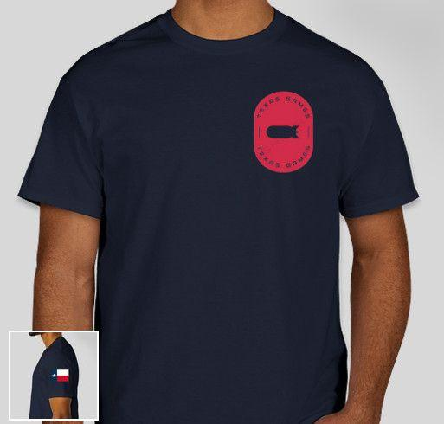
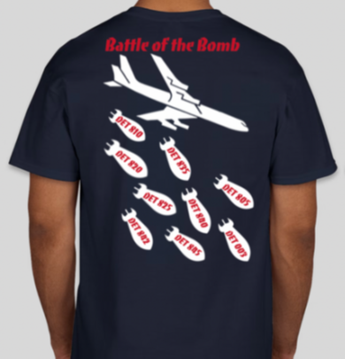

Other Items
Can order a shirt when you register.
Cost based upon # of people who order. ~$15-$20.
A bill will be sent to each Det after registration closes. 23 Feb latest for payments
Cadre can order a shirt by using the registration link(select cadre option)
Lunch will be catered for everyone registered
Water Coolers at both locations
Concession Stands
Bring tents and chairs
WX plan is to transition to Russell Gym/Student Life Center(SLC) for indoor games

Slide 6

See you there!
Baylor POCs
Cadets: C/ Col Carson Duncan
Cadre: Capt Matthew Renner

